Slide 1

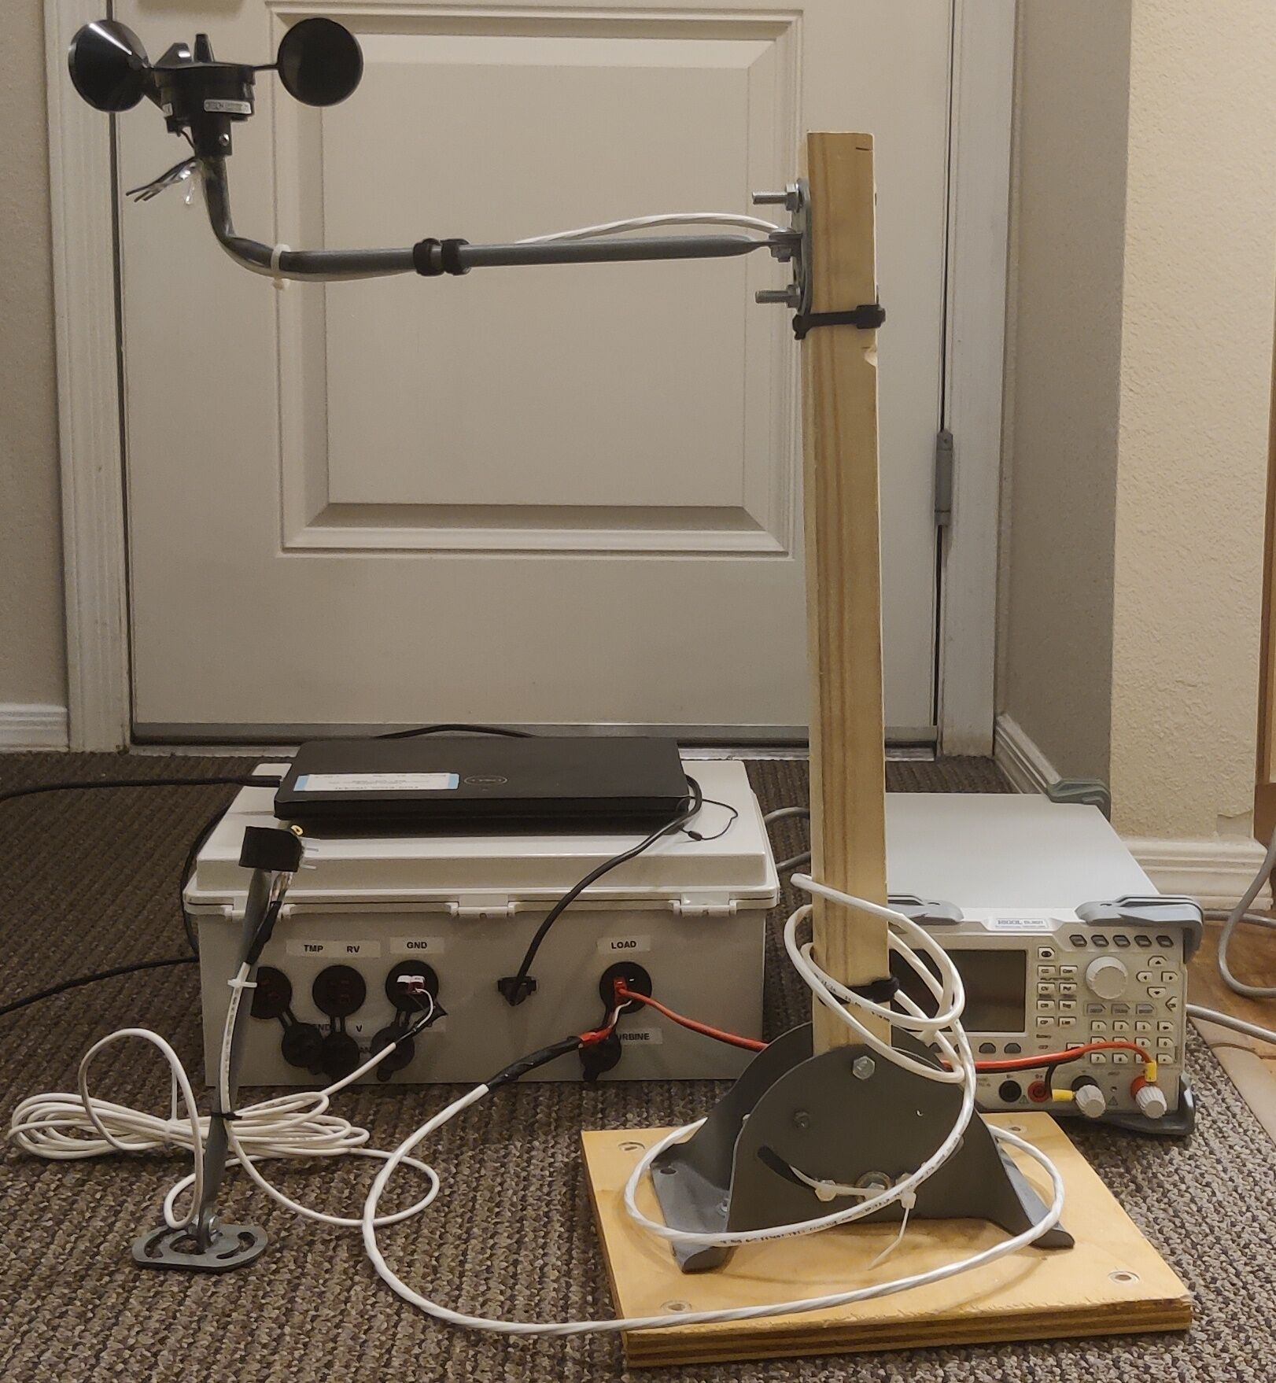
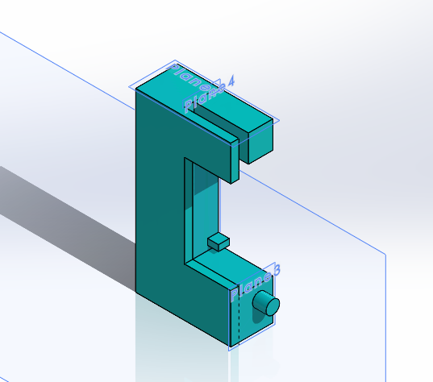
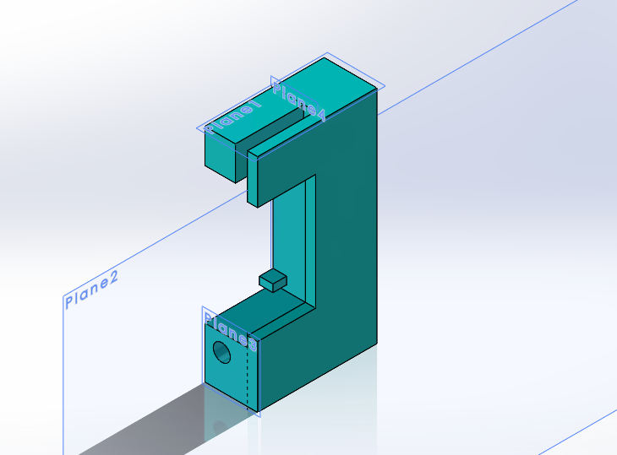
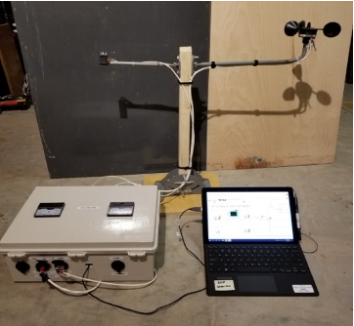
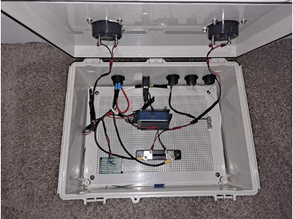
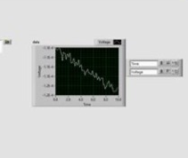
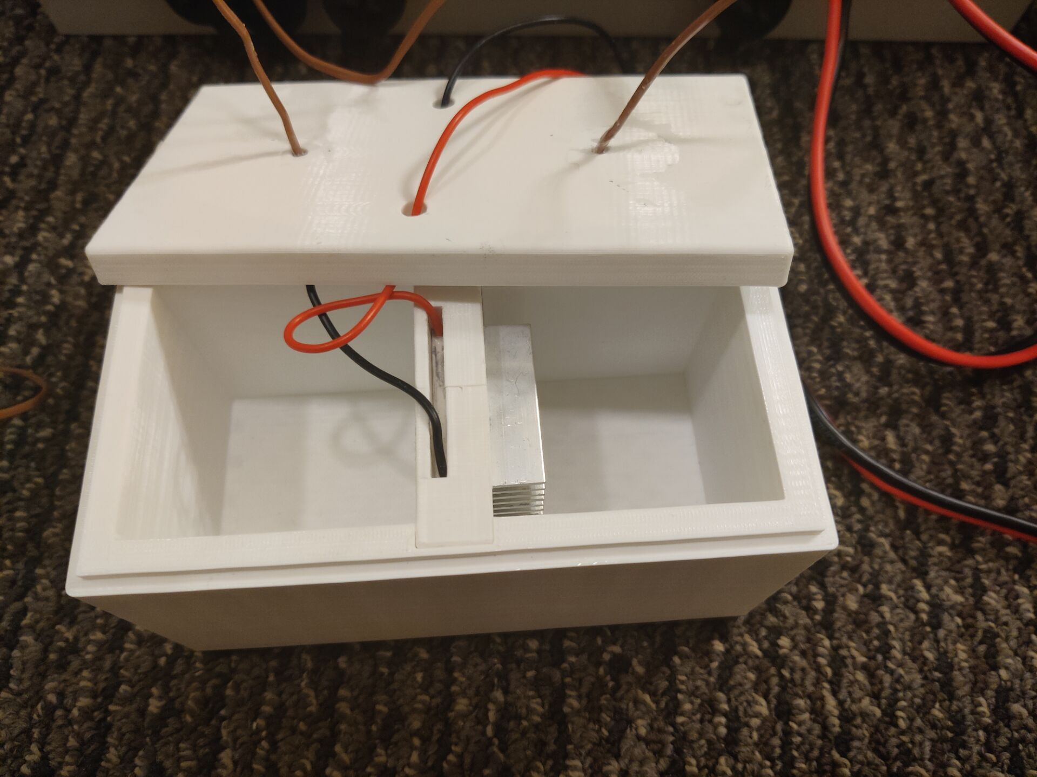
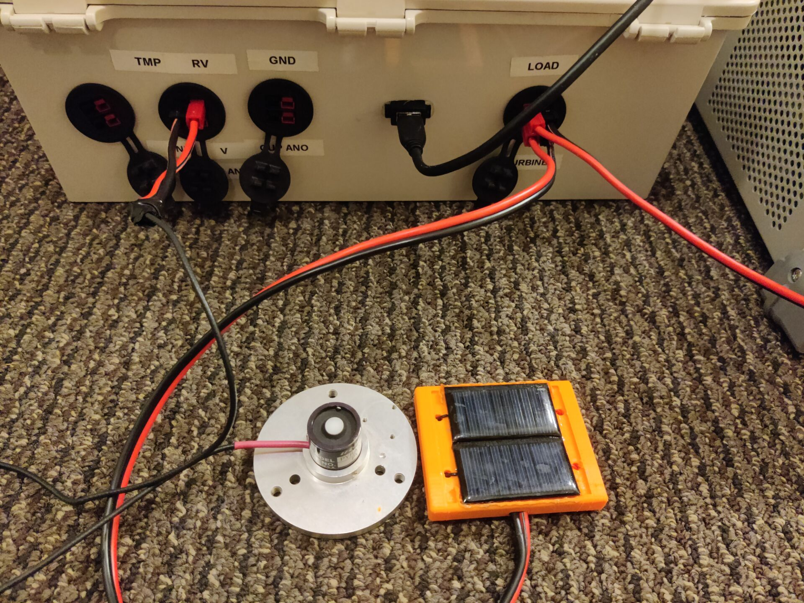
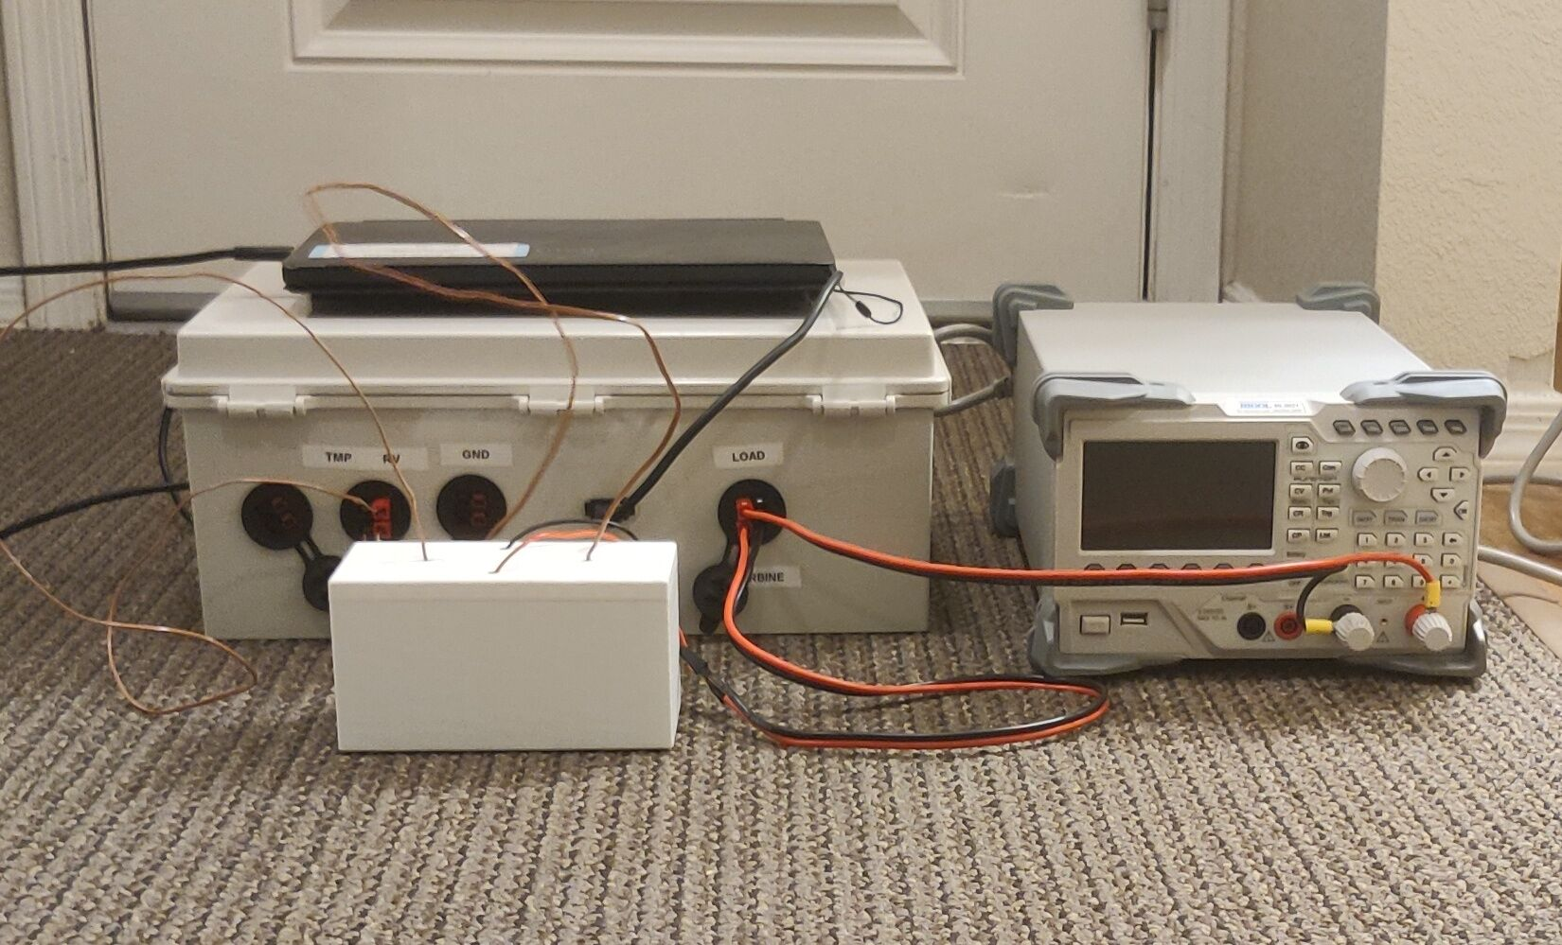
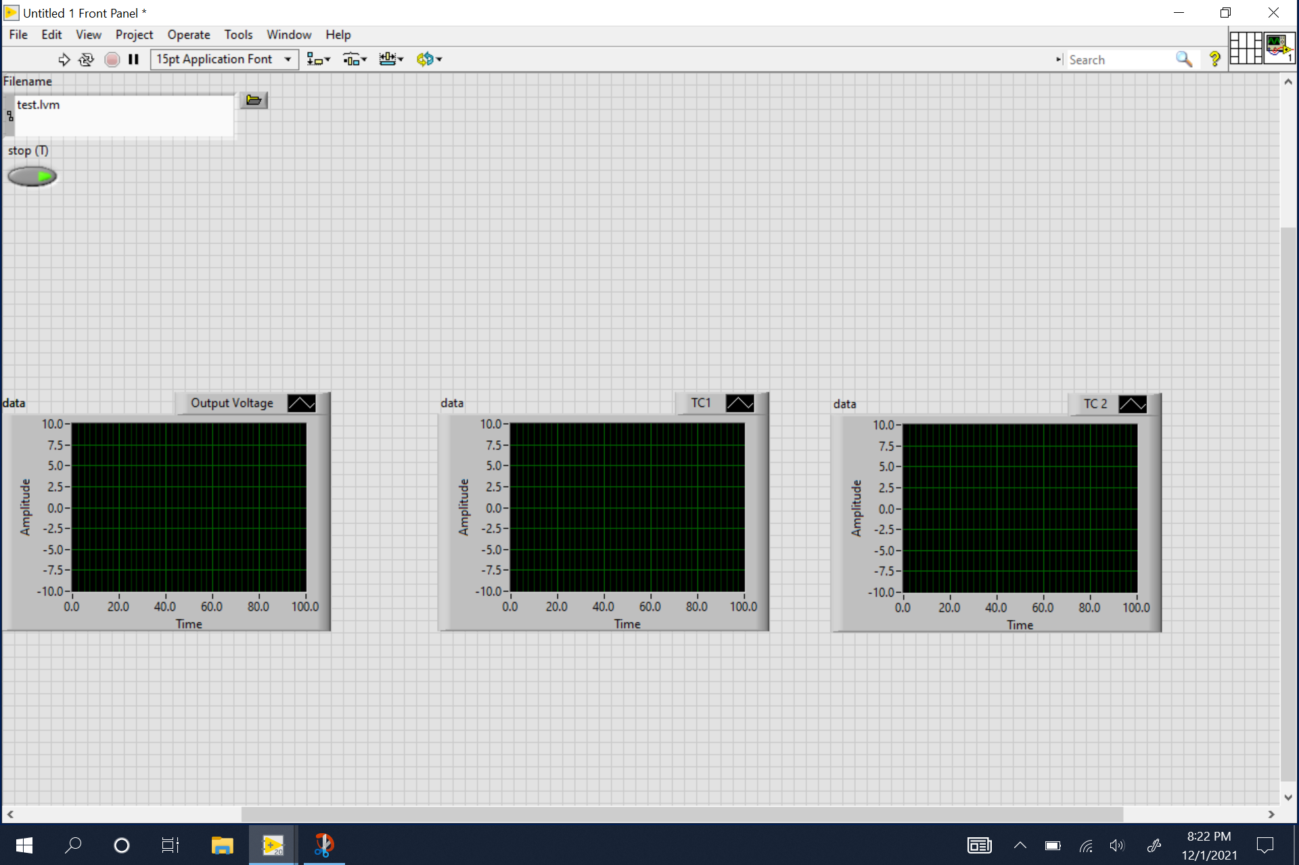
TEAM CWC PCC
Yuanhua Zhao Yuxuan Gu
College of Engineering, Informatics, and Applied Sciences, Northern Arizona University, Flagstaff, AZ 86011
Abstract
Methods
Conclusion
This project will extend the capabilities of the current CWC PCC data collection system for micro-wind turbines. Specifically, the project will add in a more flexible load option and higher resolution acquisition for characterizing solar cells and thermoelectric generators that would be used for Energy Club outreach activities. The current system collects voltage, current, wind speed, temperature, and pressure to characterize wind turbines. See photos for existing system for characterizing wind turbines.
The design includes four subsystems, operating system, solar system, thermoelectric system, and wind power system. The team‘s initial plan was modularization and centralized information. Because this device is entirely composed of electronic components, it is difficult to express the design by calculation, but the team investigated a similar successful design, and with the original system as a reference, it can be seen that the current design is reasonable. In the production process, we used welding technology, electrical technology, programming technology (Labview Vi), and made CAD.
As a result of the final test, the program runs relatively well. We divided the different test contents into three different parts. The wind power follows the past program with a slight modification. The electric heating energy uses the icon in the result part, and the solar energy is the same as above. The project added two subsystems to the original equipment, used the remaining jacks properly, maintained the independence of the information collection system, and realized the installation of the test environment. The whole is more complicated than the original equipment, there are more places to pay attention to, and it also taught the team a lot of new knowledge.
Results
The team finally built a complete CWC-PCC system, including four subsystems. Among them, the analysis subsystem collects and records the data signals of each sensor through the NI LabVIEW program on the laptop. The wind power subsystem collects wind speed data through the hot wire wind speed sensor. The operators can use this subsystem to study the relationship between wind speed and voltage generated by the wind turbine. The solar subsystem consists of solar panels and Pyranometers. Through this subsystem, the operators will study the relationship between the light intensity and the voltage generated by the solar panel. The thermoelectric subsystem obtains the temperature difference on both sides of TEG through two thermocouples and compares the temperature difference with the voltage generated by TEG.
References
[1] “Browse standards by collection: Ieee xplore,” Browse Standards by Collection | IEEE Xplore. [Online]. Available: https://ieeexplore.ieee.org/browse/standards/collection/ieee/power-and-energy?selectedValue=Testing%2C+Instrumentation+and+Measurement%2C+and+Metric+Practice&sortType=newest. [Accessed: 03-Aug-2021].
[2]“Wind Load vs. Wind Speed,” Engineering ToolBox. [Online]. Available: https://www.engineeringtoolbox.com/wind-load-d_1775.html. [Accessed: 18-Jul-2021].
[3]“Wind Energy Factsheet,” Wind Energy Factsheet | Center for Sustainable Systems. [Online]. Available: https://css.umich.edu/factsheets/wind-energy-factsheet. [Accessed: 18-Jul-2021].
[4]“Small Wind Guidebook,” WINDExchange. [Online]. Available: https://windexchange.energy.gov/small-wind-guidebook#installation. [Accessed: 18-Jul-2021].
[5]W. Yu-Ting, L. Chang-Yu and H. Che-Ming, "An Experimental Investigation of Wake Characteristics and Power Generation Efficiency of a Small Wind Turbine under Different Tip Speed Ratios," Energies, vol. 13, (8), pp. 2113, 2020. Available: http://search.proquest.com.libproxy.nau.edu/scholarly-journals/experimental-investigation-wake-characteristics/docview/2395449609/se-2?accountid=12706. DOI: http://dx.doi.org.libproxy.nau.edu/10.3390/en13082113.
Requirements
The customer requested two new sub-systems, and we derived from these two new sub-systems that solar and thermoelectric are needed. The customer is not satisfied with the current equipment, mainly because of the size problem. He did not say clearly but proposed to replace the system with a lighter and smaller raspberry. We sum up the following six points: easily carry, easily use, easily debug, reliability, solar, thermoelectric.
The team believes that the realization of functions is the most important requirement. Among other requirements, "easy to debug" is equally important. In this regard, the team will make efforts in manuals and installation and disassembly.
Then we investigated the elements required for a data collection system. Based on these elements, we concluded the following engineering requirements: Weight, size, simple operating system, test interface, modularization, durable, incorporate, rotational Energy, displays a phenomena of engineering.
Because this project is a graduate design of mechanical engineering, the team wants to reflect the students' professionalism and professionalism in this project, rather than looking for simpler solutions. The team optimizes the user experience and convenience as much as possible.
Acknowledgements
Firstly, thank our advisors David Trevas and David Willy. In this stormy and troubled 2021, we have experienced many twists and turns. From the summer when the team had to work online to the fall of the flagstaff epidemic, the project faced multiple difficulties, which were all overcome one by one. With the help of library 3D printing technology, the support of engineering lab, and many online materials, and the careful guidance of the instructor, we can complete this project. This makes us clearly understand the truth: the Great Wall is not built in a day, nor is it a person.

